Slide 1


Introduction to
Robotic Process Automation
AI MULTI
PROMPTER
BOT
Your Register No: 220701216
Name: RAKHUL PRAKASH S B
Guide Name: Dr. N Durai Murugan
Designation and Department:
Associate Professor of Computer Science and Engineering

Slide 2






Abstract
The AI Multi-Prompter Bot leverages RPA to automate the aggregation of responses from multiple AI platforms, including ChatGPT, Claude, and Gemini. It streamlines workflows by using web automation, processes responses into structured formats, and exports data to CSV or Excel. This solution enhances efficiency, reduces manual effort, and supports scalable AI-driven workflows.
Web Automation And Data Scraping
Department of Computer Science and Engineering
Rajalakshmi Engineering College 1
Notes:
2

Slide 3




Need for the Proposed System
Centralized AI Insights
Current systems rely on manual interaction with individual AI platforms, limiting efficiency. The proposed system provides a centralized solution, consolidating responses from multiple AI platforms into one interface.
Providing structured, multi-perspective AI responses helps users make more informed decisions
Manually querying multiple AI models and organizing their responses is time-consuming. Automating this process reduces effort and ensures faster data aggregation.
leveraging the strengths of various AI models effectively.
Time Saving Automation
Unified Workflow
Error Reduction
Enhanced Decision Making
Scalable Design
Department of Computer Science and Engineering
Rajalakshmi Engineering College 2
Notes:
3

Slide 4




Advantages of the Proposed System
The AI Multi-Prompter Bot offers unparalleled advantages, including automation of AI response aggregation, enhanced accuracy, and real-time efficiency. With a user-friendly interface, structured outputs, and scalability, it reduces manual effort while ensuring seamless, secure, and cost-effective workflows.
Centralized AI Management
Unified access to multiple AI platforms
Reduced need for manual switching
Streamlined workflows
Enhanced Efficiency
Significant time savings through automation
Organized responses in structured formats
Faster data processing and task completion
Better Decision-Making
Structured data for insightful analysis
Real-time processing for quick responses
Improved workflow transparency
Scalable and Future-Ready
Integration-ready design for new AI platforms
Support for additional export formats
Adaptable to evolving organizational needs
Department of Computer Science and Engineering
Rajalakshmi Engineering College 3
Notes:
4

Slide 5
Literature Survey
Downey et al., 2021.
Advantages:
Enhanced Efficiency: RPA automates routine tasks while AI models generate contextually relevant responses, reducing the need for human intervention and speeding up processes (Downey et al., 2021).
Disadvantages:
Error Handling: RPA systems may face difficulties in managing AI-generated errors, requiring complex workflows to correct or escalate issues effectively (Downey et al., 2021).
Sharma & Choudhary, 2023
Advantages:
Scalability: These systems can scale easily to accommodate high volumes of user interactions, enabling businesses to handle large numbers of requests without increasing workforce size (Sharma & Choudhary, 2023).
Disadvantages:
Limited by AI Model Performance: The effectiveness of the system is directly tied to the performance of the integrated AI models, which may generate incorrect or irrelevant responses (Kumar & Sharma, 2022).
Department of Computer Science and Engineering
Rajalakshmi Engineering College 4
Notes:
5

Slide 6



Main Objective
The main objective of the proposed system is to centralize interactions with multiple AI platforms, automating the process and reducing manual intervention. This system aims to streamline workflows, improve accuracy, and enhance decision-making by organizing AI-generated data into structured formats for easier analysis and processing. By minimizing human errors and optimizing data handling, the system ensures a more efficient and reliable approach to AI-driven tasks, with scalability for future integration and adaptability to changing requirements. Ultimately, it seeks to save time, reduce complexity, and deliver actionable insights for better business outcomes.
Department of Computer Science and Engineering
Rajalakshmi Engineering College 5
Notes:
6

Slide 7
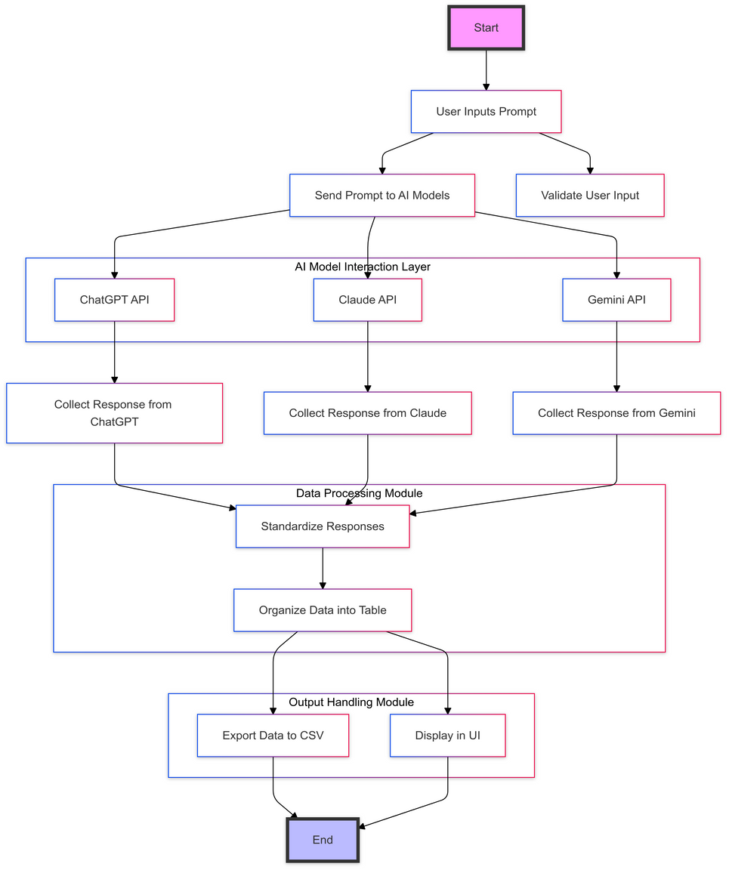
Architecture
User Interface: User inputs prompts through a simple interface.
AI Model Integration: Prompts are sent to multiple AI models (ChatGPT, Claude, Gemini).
Response Collection: AI responses are gathered.
Data Processing: Responses are formatted into a structured table (CSV/Excel).
Output Management: Data is exported or saved for user access.
Efficient Workflow: Streamlined, simple architecture with no added complexity.
Department of Computer Science and Engineering
Rajalakshmi Engineering College 6
Notes:
7

Slide 8

System Requirements
Hardware Requirements:
Processor: Multi-core processor (i5 or above recommended)
RAM: Minimum 4GB (16GB recommended for optimal performance)
Storage: At least 100GB of free disk space (SSD preferred for faster performance)
Network: Stable internet connection for accessing AI models
Display: Standard resolution display (1920x1080 or higher)
Software Requirements:
Operating System: Windows 10 or higher, macOS, or Linux
AI Integration Platforms: Access to APIs for ChatGPT, Claude, Gemini (via OpenAI, Anthropic, Google)
Programming Languages: Python 3.8 or above
Office Software: Microsoft Excel or compatible software for file opening (for Excel export)
Department of Computer Science and Engineering
Rajalakshmi Engineering College 7
Notes:
8

Slide 9
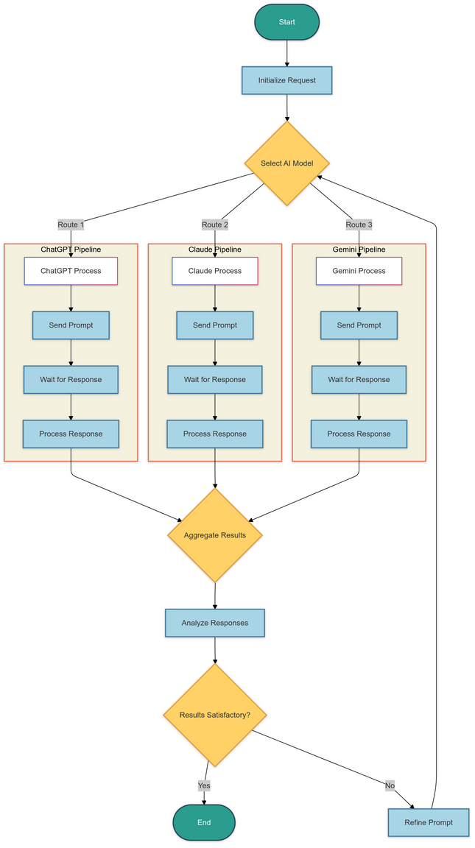
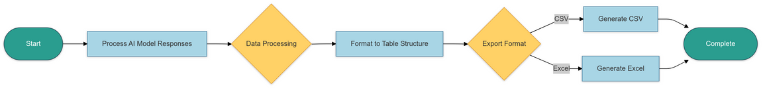
Functional Description
DFD / Activity Diagram
Module 1
AI Interaction and Data Retrieval
Short Description:
Module 1 handles the interaction with the AI models (ChatGPT, Claude, and Gemini) by sending user prompts, receiving responses, and storing the data. It automates the communication with the AI platforms, ensuring that each model is accessed in sequence, and responses are retrieved efficiently for further processing.
Module 2
Data Processing and Output
Short Description:
Module 2 is responsible for processing the responses from the AI models. It formats the data into structured tables, performs any necessary transformations, and then exports the results to CSV or Excel formats for user access. This module ensures that the data is easy to manipulate and share for further analysis.
Department of Computer Science and Engineering
Rajalakshmi Engineering College 8
Notes:
9

Slide 10
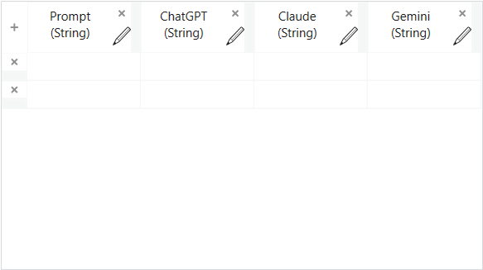
DataTable Design
Prompt (String):
This column stores the text of the user's input or the prompt that is sent to the AI models. It is the key data for initiating the AI model responses.
ChatGPT (String):
This column stores the response generated by the ChatGPT model. The response is stored as a string to capture the output text returned by the model.
Claude (String):
This column stores the response generated by the Claude model. The response is stored in a string format, similar to the ChatGPT response, for consistency.
Gemini (String):
This column stores the response generated by the Gemini model. It also captures the AI-generated text output as a string.
DataTable For CSV
Department of Computer Science and Engineering
Rajalakshmi Engineering College 9
Notes:
10

Slide 11
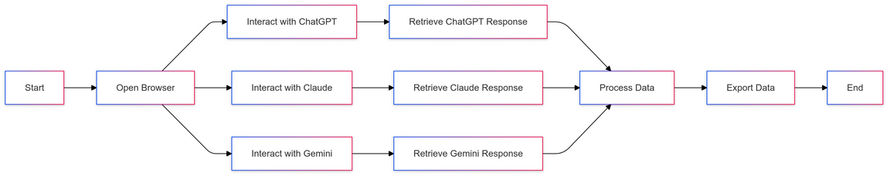
Process Design
Main Process
Sub Process
The main process in the AI Multi-Prompter Bot starts by initiating interactions with multiple AI models. It first triggers the sequence to open the required browser and interact with the AI platforms (such as ChatGPT, Claude, and Gemini). This sequence is defined in the main process to facilitate smooth interaction and seamless communication with each AI model.
The sub-processes handle the individual tasks within the main flow. For example, a sub-process is used to send the prompt to the AI model, receive the response, and then process the output. These tasks are executed step-by-step for each AI model (ChatGPT, Claude, Gemini). Each step in the sub-process ensures a detailed interaction, such as typing a prompt, waiting for a response, and displaying it.
Main Process
Sub Process
Department of Computer Science and Engineering
Rajalakshmi Engineering College 10
Notes:
11

Slide 12
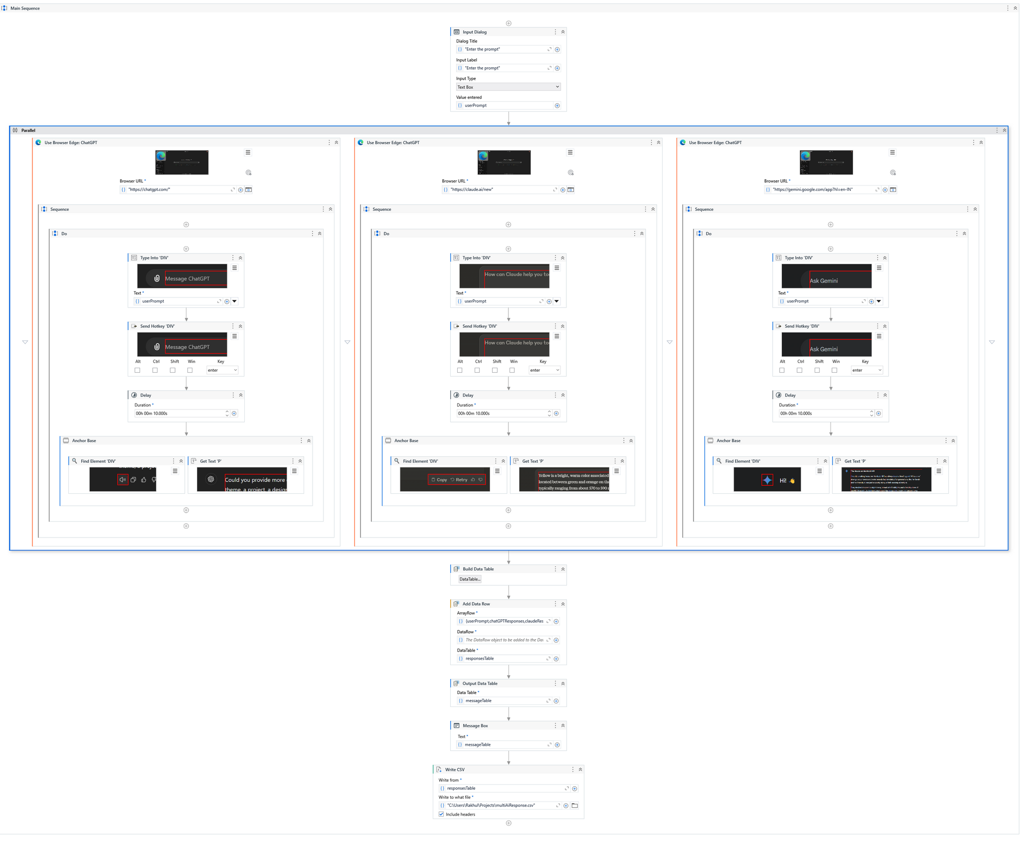
Implementation
Implementation of Module 1: Interfacing with AI Models
Description: Module 1 handles the interaction with the AI models. It initiates the process by opening the browser and interacting with the interface of the respective AI models. The flow begins by typing a predefined prompt into the AI platform (ChatGPT in this case), followed by receiving the output from the model. The prompt and output are logged and used for further processing. This module also handles necessary delays and input to ensure proper data flow.
Department of Computer Science and Engineering
Rajalakshmi Engineering College 11.a
Notes:
12

Slide 13
Implementation
Implementation of Module 2: Data Processing and Export
Description: Module 2 handles the data processing of the responses received from the AI models. Once the output is received, it is processed into a structured format (such as CSV or Excel). This module ensures that the data is organized, and relevant details are extracted. It also handles the export functionality, saving the processed data into a file that can be accessed by the user.
Department of Computer Science and Engineering
Rajalakshmi Engineering College 11.b
Notes:
12

Slide 14
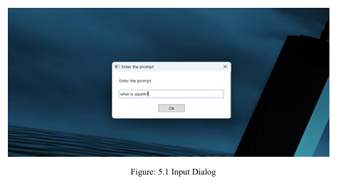
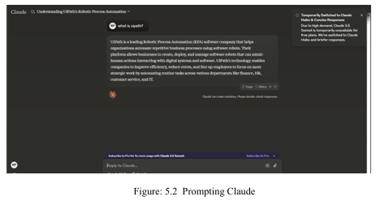
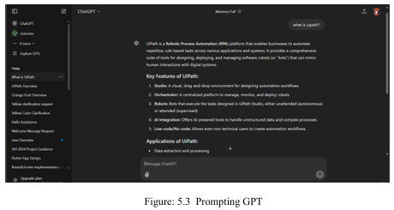
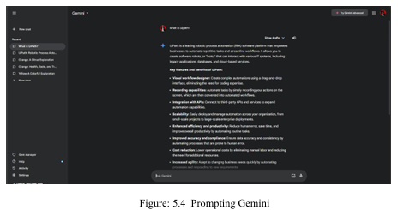
Testing & Screenshots
The AI Multi-Prompter Bot was thoroughly tested for functionality, reliability, and accuracy, including unit and integration testing for seamless AI interactions
Department of Computer Science and Engineering
Rajalakshmi Engineering College 12
Notes:
13

Slide 15
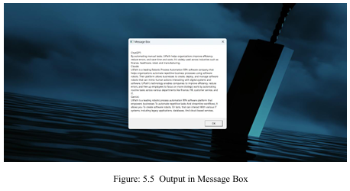
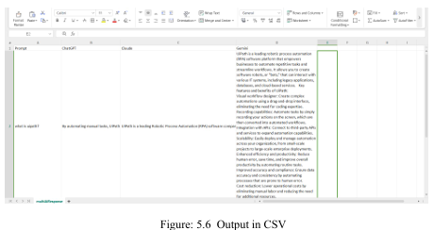
Testing & Screenshots
The screenshots above illustrate the key features and output of the AI Multi-Prompter Bot, including the user input prompt, responses from multiple AI models, and the structured data export in CSV and Excel formats. These screenshots provide a visual representation of the system's user interface, highlighting its simplicity and effectiveness in automating the aggregation and processing of AI responses.
Department of Computer Science and Engineering
Rajalakshmi Engineering College 13
Notes:
13

Slide 16
Conclusions
The implementation of Robotic Process Automation (RPA) in the AI Multi Prompter Bot has successfully streamlined the process of aggregating and organizing responses from multiple AI platforms, including ChatGPT, Claude, and Gemini. By automating repetitive and time-consuming tasks, this system minimizes manual intervention, enhances the accuracy of data collection, and improves overall operational efficiency. The user interacts minimally by providing a prompt, while the bot handles the tasks of automating web interactions, fetching responses from the AI platforms, processing the data into structured formats, and exporting the results into CSV or Excel files.
Department of Computer Science and Engineering
Rajalakshmi Engineering College 14
Notes:
14

Slide 17
Future Enhancement
Integration with Additional AI Models: Expanding the system to support new and emerging AI platforms for even broader insights.
Support for Advanced Export Formats: Adding options to export data in JSON, PDF, or directly into database systems for more versatile use cases.
Multi-Language Support: Enabling input prompts and responses in multiple languages to cater to a global user base or diverse linguistic needs.
Real-Time Collaboration: Allowing multiple users to input prompts and access results simultaneously for collaborative decision-making.
AI Response Summarization: Incorporating Natural Language Processing (NLP) to generate concise summaries of AI responses for quick reviews.
Department of Computer Science and Engineering
Rajalakshmi Engineering College 15
Notes:
15

Slide 18
References
Avasarala, V. (2020). Robotic Process Automation: Guide for Beginners. Packt Publishing.
Lacity, M. C., & Willcocks, L. P. (2018). Robotic Process Automation and Cognitive Automation: The Next Phase. BPTrends.
Willcocks, L. P., & Lacity, M. C. (2016). Robotic Process Automation: The Next Transformation in Business Process Outsourcing. Journal of Information Technology Teaching, 33(4), 44-52.
Avasarala, V. (2021). RPA in AI Systems: Automation of Prompt Aggregation and Reporting. International Journal of Applied Research, 8(3), 256-267.
UiPath (2023). Robotic Process Automation for AI Workflows. Retrieved from www.uipath.com.
Department of Computer Science and Engineering
Rajalakshmi Engineering College 16
Notes:
17

Slide 19
Queries
Notes:
18

Slide 20
Demonstration
Notes:
19

Slide 21
Thank You
Notes:
20

